Slide 1

Pattern Classification
All materials in these slides were taken from
Pattern Classification (2nd ed) by R. O. Duda, P. E. Hart and D. G. Stork, John Wiley & Sons, 2000 with the permission of the authors and the publisher

Slide 2
Chapter 2 :
Bayesian Decision Theory
(Sections 1-6)
1. Introduction – Bayesian Decision Theory
  Pure statistics, probabilities known, optimal decision
2. Bayesian Decision Theory–Continuous Features
3. Minimum-Error-Rate Classification (omit)
4. Classifiers, Discriminant Functions, Decision Surfaces
5. The Normal Density
6. Discriminant Functions for the Normal Density

Slide 3
Bayesian Decision Theory
Design classifiers to make decisions subject to minimizing an expected ”risk”.
  The simplest risk is the classification error.
  When misclassification errors are not equally important, the risk can include the cost associated with different misclassification errors.

Slide 4
Terminology
State of nature ω (class label):
  e.g., ω₁ for sea bass, ω₂ for salmon
Probabilities P(ω₁) and P(ω₂) (priors):
  e.g., prior knowledge of how likely is to get a sea bass or a salmon
Probability density function p(x) (evidence):
  e.g., how frequently we will measure a pattern with feature value x (e.g., x corresponds to lightness)

Slide 5
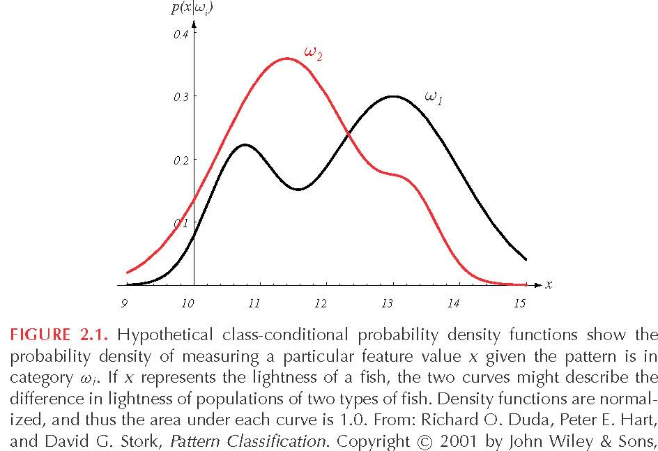
Terminology (cont’d)
Conditional probability density p(x/ω_{j}) (likelihood) :
  e.g., how frequently we will measure a pattern with feature value x given that the pattern belongs to class ω_{j}
e.g., lightness distributions
between salmon/sea-bass
populations

Slide 6
Terminology (cont’d)
Conditional probability P(ω_{j} /x) (posterior) :
  e.g., the probability that the fish belongs to class ω_{j} given feature x.

Slide 7
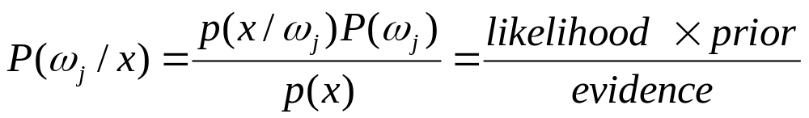
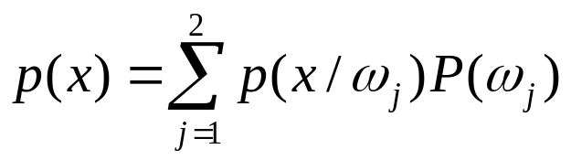
Decision Rule Using
Conditional Probabilities
Using Bayes’ rule:
where (i.e., scale factor – sum of probs = 1)
Decide ω₁ if P(ω₁ /x) > P(ω₂ /x); otherwise decide ω₂ or
Decide ω₁ if p(x/ω₁)P(ω₁)>p(x/ω₂)P(ω₂); otherwise decide ω₂
or
Decide ω₁ if p(x/ω₁)/p(x/ω₂) >P(ω₂)/P(ω₁) ; otherwise decide ω₂
likelihood ratio
threshold

Slide 8
1. Introduction
The sea bass/salmon example
  State of nature, prior
    State of nature is a random variable
    The catch of salmon and sea bass is equiprobable
      P(ω₁) = P(ω₂) (uniform priors)
      P(ω₁) + P( ω₂) = 1 (exclusivity and exhaustivity)
Pattern Classification, Chapter 2 (Part 1)

Slide 9
Decision rule with only the prior information
  Decide ω₁ if P(ω₁) > P(ω₂) otherwise decide ω₂
Use of the class –conditional information
P(x | ω₁) and P(x | ω₂) describe the difference in lightness between populations of sea and salmon
Pattern Classification, Chapter 2 (Part 1)

Slide 10
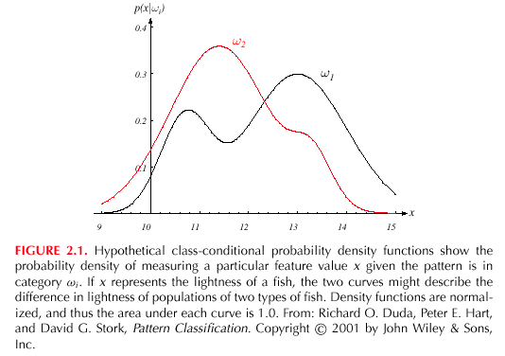
Pattern Classification, Chapter 2 (Part 1)

Slide 11
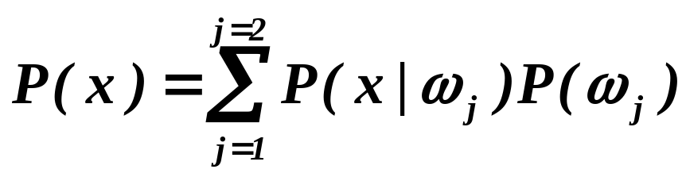
Posterior, likelihood, evidence
  P(ω_{j} | x) = P(x | ω_{j}) P (ω_{j}) / P(x) (Bayes Rule)
  Where in case of two categories
  Posterior = (Likelihood. Prior) / Evidence
Pattern Classification, Chapter 2 (Part 1)

Slide 12
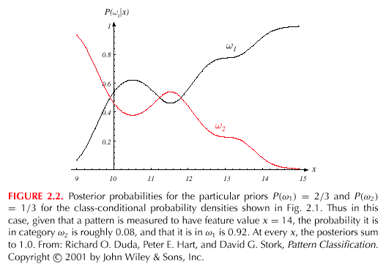
Pattern Classification, Chapter 2 (Part 1)

Slide 13
Decision given the posterior probabilities
X is an observation for which:
if P(ω₁ | x) > P(ω₂ | x) True state of nature = ω₁
if P(ω₁ | x) < P(ω₂ | x) True state of nature = ω₂
Pattern Classification, Chapter 2 (Part 1)

Slide 14
2. Bayesian Decision Theory – Continuous Features
Generalization of the preceding ideas
  Use of more than one feature, vector X
  Use more than two states of nature, c classes
  Allowing actions other than deciding the state of nature (skip)
  Introduce a loss of function which is more general than the probability of error (skip)
Pattern Classification, Chapter 2 (Part 1)

Slide 15
4. Classifiers, Discriminant Functions, and Decision Surfaces
The multi-category case
  Set of discriminant functions g_{i}(x), i = 1,…, c
  The classifier assigns a feature vector x to class ω_{i}
  if:
  g_{i}(x) > g_{j}(x) ∀j ≠ i
Pattern Classification, Chapter 2 (Part 2)

Slide 16
Discriminant function
  g_{i}(x) = P(ω_{i} | x)
(max. discrimination corresponds to max. posterior!)
g_{i}(x) ≡ P(x | ω_{i}) P(ω_{i})
g_{i}(x) = ln P(x | ω_{i}) + ln P(ω_{i})
(ln: natural logarithm!)
Pattern Classification, Chapter 2 (Part 2)

Slide 17
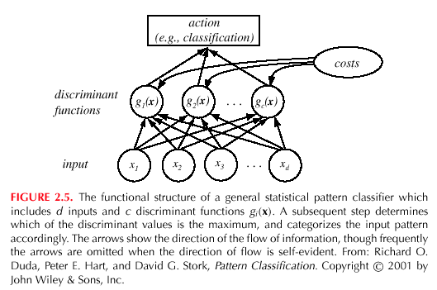
Pattern Classification, Chapter 2 (Part 2)

Slide 18
Feature space divided into c decision regions
if g_{i}(x) > g_{j}(x) ∀j ≠ i then x is in R_{i}
(R_{i} means assign x to ω_{i})
The two-category case
  A classifier is a “dichotomizer” that has two discriminant functions g₁ and g₂
  Let g(x) ≡ g₁(x) – g₂(x)
  Decide ω₁ if g(x) > 0 ; Otherwise decide ω₂
Pattern Classification, Chapter 2 (Part 2)

Slide 19
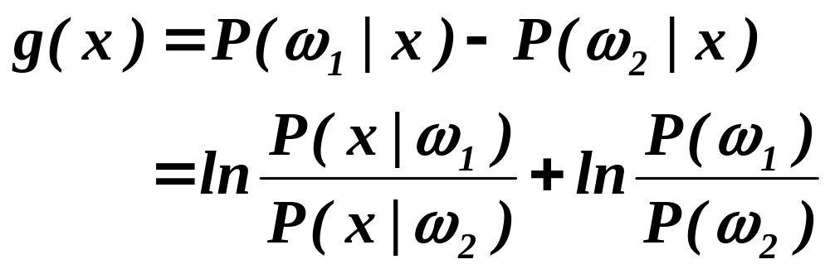
  The computation of g(x)
Pattern Classification, Chapter 2 (Part 2)

Slide 20
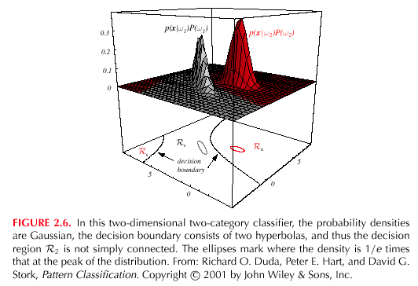
Pattern Classification, Chapter 2 (Part 2)

Slide 21
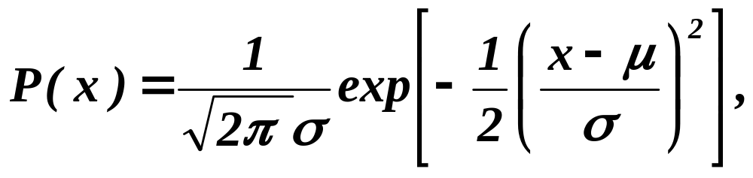
5. The Normal Density
Univariate density
  Density which is analytically tractable
  Continuous density
  A lot of processes are asymptotically Gaussian
  Handwritten characters, speech sounds are ideal or prototype corrupted by random process (central limit theorem)
Where:
μ = mean (or expected value) of x
σ² = expected squared standard deviation or variance
Pattern Classification, Chapter 2 (Part 2)

Slide 22
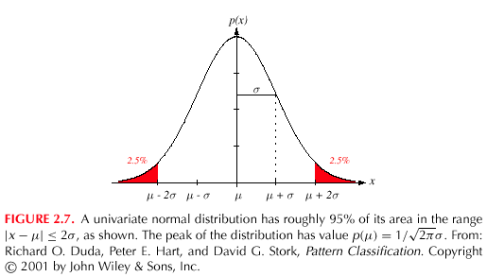
Pattern Classification, Chapter 2 (Part 2)

Slide 23
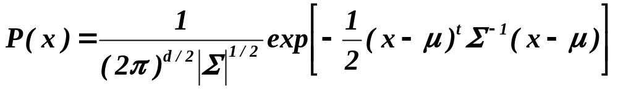
Multivariate normal density p(x) ~ N(μ, Σ)
  Multivariate normal density in d dimensions is:
where:
x = (x₁, x₂, …, x_{d})^{t} (t stands for the transpose vector form)
μ = (μ₁, μ₂, …, μ_{d})^{t} mean vector
Σ = d*d covariance matrix
|Σ| and Σ⁻¹ are determinant and inverse respectively
Σ
Pattern Classification, Chapter 2 (Part 2)

Slide 24
Properties of the Normal Density
Covariance Matrix Σ
Always symmetric
Always positive semi-definite, but for our purposes Σ is positive definite
  determinant is positive
  Σ invertible
Eigenvalues real and positive, and the principal axes of the hyperellipsoidal loci of points of constant density are eigenvectors of Σ

Slide 25
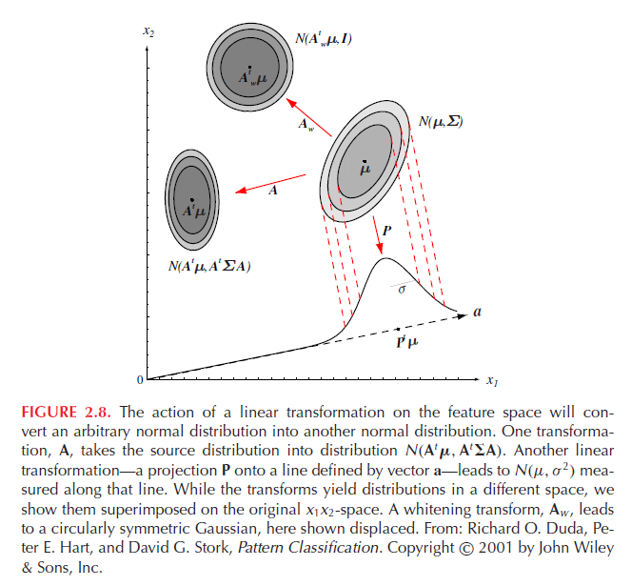
Σ
Pattern Classification, Chapter 2 (Part 2)

Slide 26
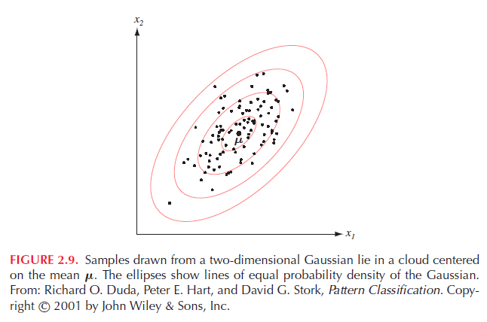
Σ
Pattern Classification, Chapter 2 (Part 2)

Slide 27
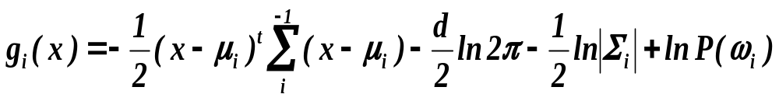
6. Discriminant Functions for the Normal Density
We saw that the minimum error-rate classification can be achieved by the discriminant function
g_{i}(x) = ln P(x | ω_{i}) + ln P(ω_{i})
Case of multivariate normal p(x) ~ N(μ, Σ)
Pattern Classification, Chapter 2 (Part 3)

Slide 28
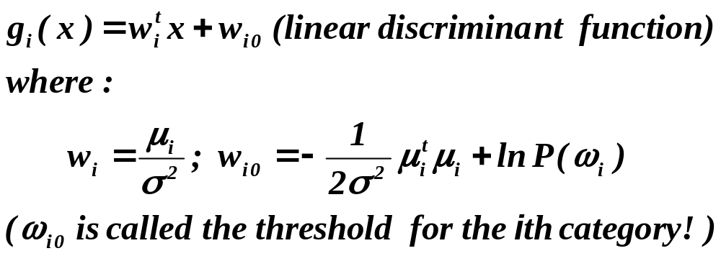
Case Σ_{i} = σ² I (I stands for the identity matrix)
Pattern Classification, Chapter 2 (Part 3)

Slide 29
A classifier that uses linear discriminant functions is called “a linear machine”
The decision surfaces for a linear machine are pieces of hyperplanes defined by:
g_{i}(x) = g_{j}(x)
If equal priors for all classes, this reduces to the minimum-distance classifier where an unknown is assigned to the class of the nearest mean
Pattern Classification, Chapter 2 (Part 3)

Slide 30
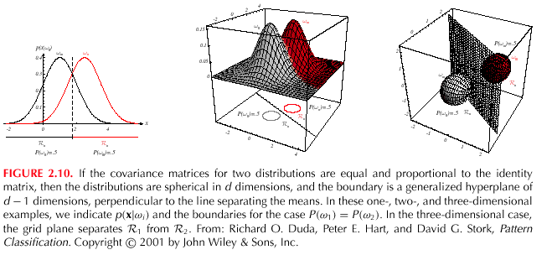
Pattern Classification, Chapter 2 (Part 3)

Slide 31
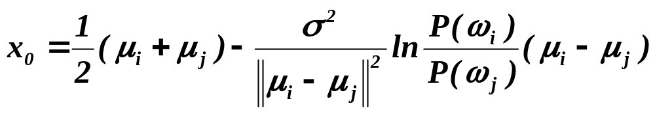
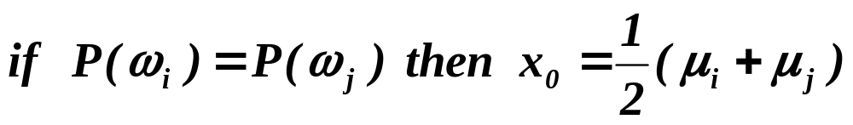
  The hyperplane separating R_{i} and R_{j}
always orthogonal to the line linking the means!
Pattern Classification, Chapter 2 (Part 3)

Slide 32
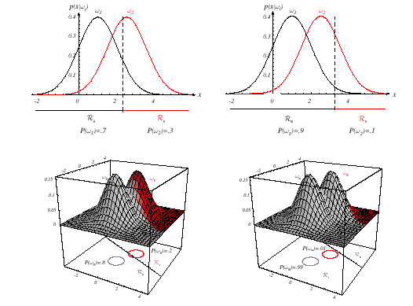
Pattern Classification, Chapter 2 (Part 3)

Slide 33
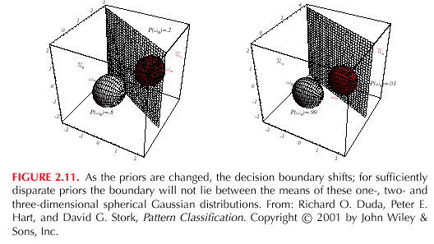
Pattern Classification, Chapter 2 (Part 3)

Slide 34
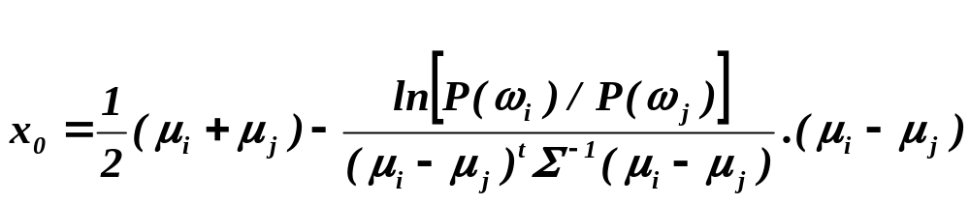
2. Case Σ_{i} = Σ (covariance of all classes are identical but arbitrary!)
  Hyperplane separating R_{i} and R_{j}
  (the hyperplane separating R_{i} and R_{j} is generally not orthogonal to the line between the means!)
  If priors equal, reduces to squared Mahalanobis distance
Pattern Classification, Chapter 2 (Part 3)

Slide 35
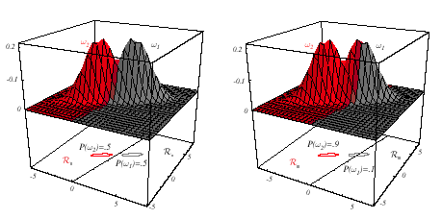
Pattern Classification, Chapter 2 (Part 3)

Slide 36
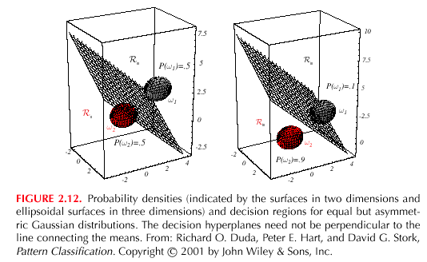
Pattern Classification, Chapter 2 (Part 3)

Slide 37
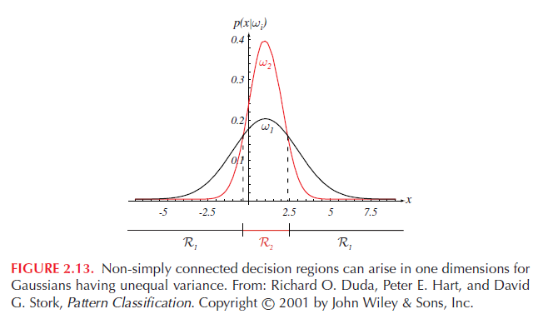
Pattern Classification, Chapter 2 (Part 3)

Slide 38
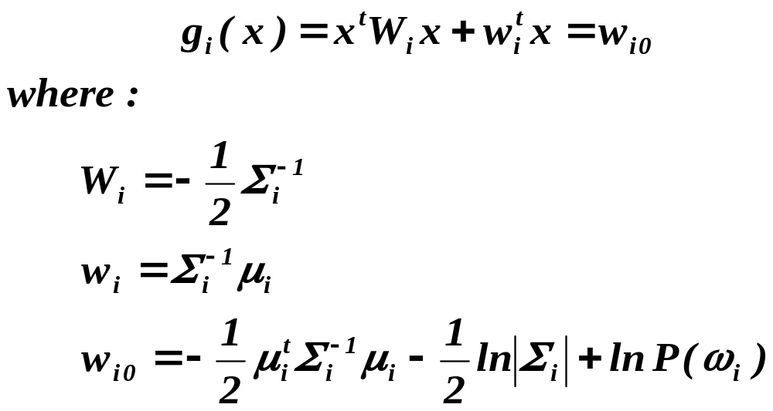
3. Case Σ_{i} = arbitrary
  The covariance matrices are different for each category
  (Hyperquadrics which are: hyperplanes, pairs of hyperplanes, hyperspheres, hyperellipsoids, hyperparaboloids, hyperhyperboloids)
Pattern Classification, Chapter 2 (Part 3)

Slide 39
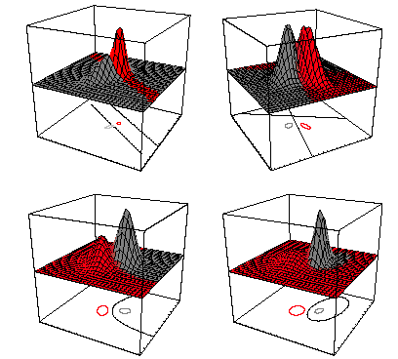
Pattern Classification, Chapter 2 (Part 3)

Slide 40
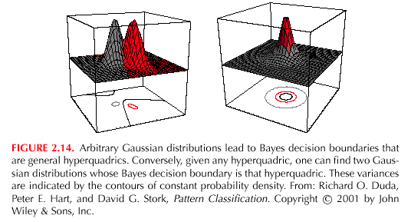
Pattern Classification, Chapter 2 (Part 3)

Slide 41
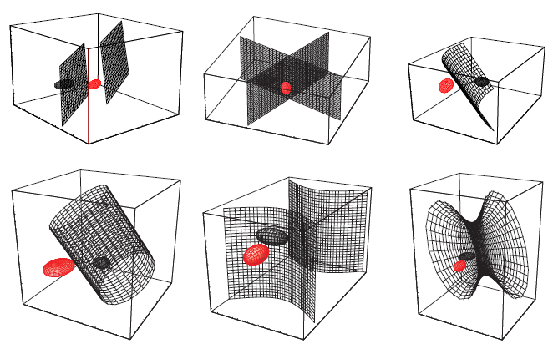
Pattern Classification, Chapter 2 (Part 3)

Slide 42
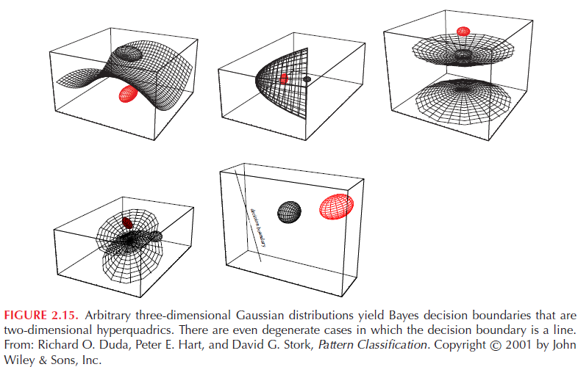
Pattern Classification, Chapter 2 (Part 3)

Slide 43
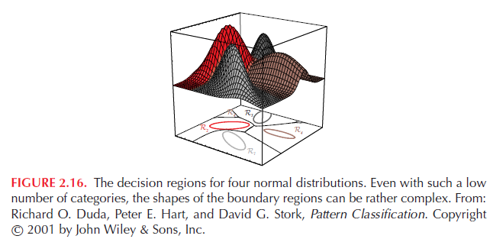
Pattern Classification, Chapter 2 (Part 3)

Slide 44
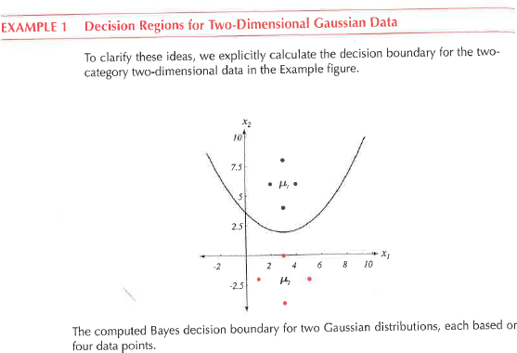
Pattern Classification, Chapter 2 (Part 3)

